Slide 1



Retail Sales & Business Performance Analytics Using SQL
MySQL Workbench and Power BI
Shreya S | Data Analytics
Notes:
Introduce yourself and the project title.

Slide 2



Project information
Retail sales analytics
Business performance
Studying a retail business's sales data to see what sells, where and to whom.
How well the business does on sales, profit, stock and payments.
Database (retail_analytics_db)
Power BI dashboard
Organised storage of the project data in nine linked tables.
A visual report with filters, KPI cards and charts built for management.
Notes:
Define the main ideas in the project in simple words: retail sales analytics, business performance, the database, and the Power BI dashboard.

Slide 3




Introduction to SQL
SQL (Structured Query Language) is the standard language for creating, storing, retrieving and analysing data in relational databases.
Define
Manage
Query
Automate
Create databases, tables, keys and rules
Insert, update and organise records
Filter, join and summarise data
Reuse logic with views, procedures and triggers
Tools used: MySQL Workbench for SQL and the ER diagram, Power BI for the dashboard.
Notes:
Keep this short: what SQL is, what it can do, and which tools you used.

Slide 4
Relational database basics
Table
Row and column
Primary key
Stores one type of record, such as customers, in rows and columns.
A row is one record; a column is one attribute, such as city.
A column that uniquely identifies each row, such as order_id.
Foreign key
Constraint
Relationship
A column that points to the primary key of another table.
A rule the database enforces, such as NOT NULL, UNIQUE or CHECK.
How tables connect: one customer can place many orders.
Notes:
SQL works on relational databases: data is split into linked tables so nothing is repeated.

Slide 5
Types of SQL commands
DDL: Define
DML: Change
DQL: Query
Data Definition Language. CREATE, ALTER and DROP set up tables and structure.
Data Manipulation Language. INSERT, UPDATE and DELETE change the records.
Data Query Language. SELECT reads and analyses data without changing it.
TCL: Control
DCL: Access
Used in this project
Transaction Control Language. COMMIT and ROLLBACK save or undo a group of changes.
Data Control Language. GRANT and REVOKE decide who can use the data.
DDL, DML, DQL and TCL. DCL was not needed here.
Notes:
SQL commands are grouped by purpose. This project used four of the five groups.

Slide 6
How a query is built
SELECT
FROM
JOIN
WHERE
Chooses which columns to show.
Names the table the data comes from.
Links tables using a matching column.
Filters rows before they are grouped.
GROUP BY
HAVING
ORDER BY
LIMIT
Groups rows so they can be summarised.
Filters the groups after summarising.
Sorts the result.
Keeps only the first few rows.
Notes:
These are the main parts of a SELECT query, in the order they are written.

Slide 7
Advanced analysis in SQL
Aggregate functions
Joins
Subquery
SUM, COUNT, AVG, MIN and MAX summarise many rows into one value.
INNER and LEFT joins combine tables; LEFT finds records with no match.
A query inside another query, such as comparing with an average.
CTE
Window functions
CASE
A named temporary result (WITH) that makes long queries easier to read.
RANK, LAG and running totals compare rows without collapsing them.
Conditional logic that labels rows, such as Low, Medium or High value.
Notes:
These features were used for the sales, ranking and trend analysis.

Slide 8
Reusable database objects
View
Stored procedure
Function
A saved query that behaves like a virtual table.
A saved block of SQL you run with CALL, such as a sales report for a date range.
A saved routine that returns one value, such as a discounted item value.
Trigger
Transaction
Index
Code that runs automatically when data changes, such as logging a price change.
A group of statements that are all saved (COMMIT) or all undone (ROLLBACK).
A lookup structure that makes filtering and joining faster.
Notes:
These objects make the database reusable and automatic.

Slide 9



What I have done
Database design
Data entry
Basic analysis
Created 9 related tables with keys and rules
Loaded 10 customers, 15 products, 25 orders and 25 payments
Filtered, sorted and counted data for everyday questions
Sales analysis
Advanced analytics
Data quality
Totals by month, product, region, channel and customer
Joins, subqueries, ranking and month-on-month change
Checked for missing, duplicate and invalid data
Automation
Dashboard
Insights
Built a view, procedure, function, trigger and indexes
Built a Power BI dashboard with filters and charts
Answered ten management questions with recommendations
Notes:
A one-minute summary of the full project, from design to recommendations.

Slide 10
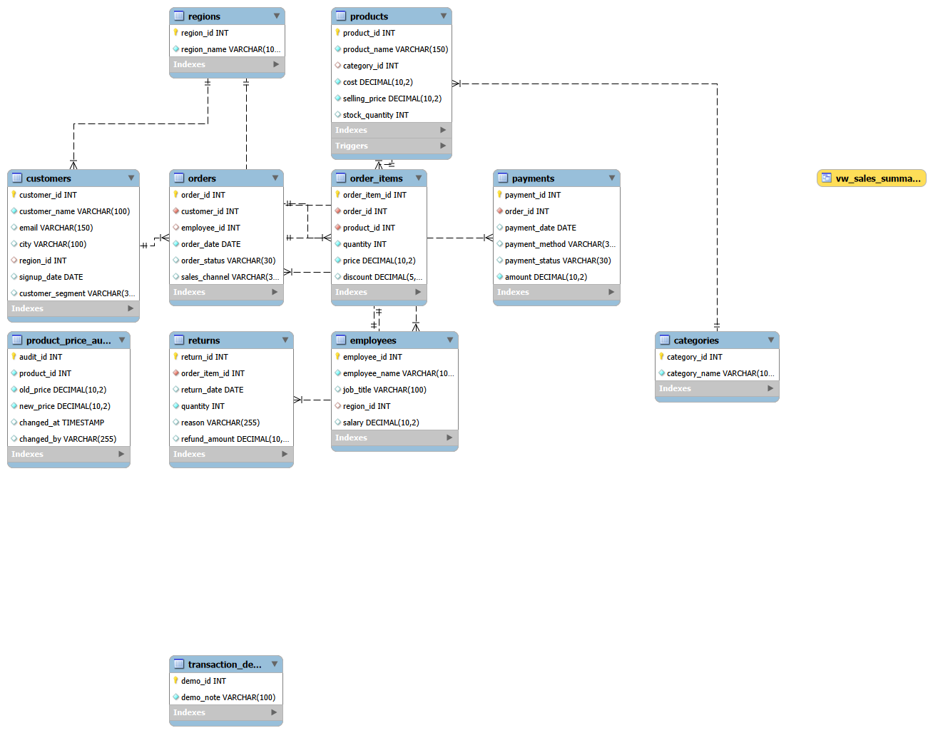
ER diagram
Master data
regions, categories, customers, products, employees
Transactions
orders, order_items, payments, returns
Extras
product_price_audit, vw_sales_summary
Primary and foreign keys link the tables.
Notes:
Exported from MySQL Workbench. Orders link customers and employees; order items link orders to products; payments and returns hang off orders and order items.

Slide 11
ER diagram: master data tables
regions
categories
customers
The sales regions, such as South and West. Each has a region_id.
Product groups such as Electronics. Each product has one category.
One row per customer, linked to a region through region_id.
products
employees
Why separate tables
Product name, cost and stock quantity, linked to a category.
Staff details, kept apart from the sales records.
Each fact is stored once, so names are not repeated in every order.

Slide 12
ER diagram: transaction tables
orders
order_items
payments
One row per order: customer, date, status and sales channel.
The products in each order, with quantity, price and discount.
The amount paid for each order, used to check payments.
returns
product_price_audit
vw_sales_summary
Records of orders that were returned by customers.
A log filled by a trigger whenever a product price changes.
A saved query (view) that works like a virtual table for reports.

Slide 13
ER diagram: how tables connect
Region to customers
Customer to orders
Order to order items
One region has many customers, linked by region_id.
One customer can place many orders, linked by customer_id.
One order contains many items, linked by order_id.
Product to order items
Order to payments
Category to products
One product can appear in many order items, linked by product_id.
Each order has a payment record, linked by order_id.
One category has many products, linked by category_id.

Slide 14
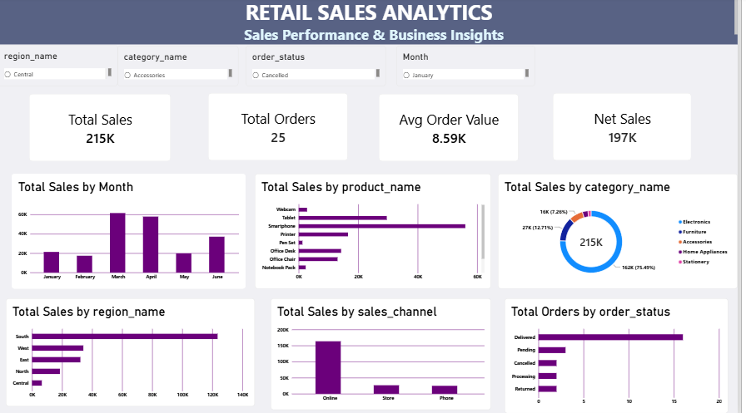
Power BI dashboard
4 slicers
Filter by region, category, order status and month
4 KPI cards
Total sales, total orders, average order value, net sales
6 charts
Month, product, category, region, channel and order status
Notes:
Open the Power BI report and click a slicer to show the visuals filtering together.

Slide 15
Dashboard: slicers
Region
Category
Order status
Shows sales for one region, or for all regions together.
Shows sales for one product category, such as Electronics.
Filters Delivered, Pending, Processing, Cancelled or Returned orders.
Month
Linked together
Why use them
Filters the data by month, from January to June 2025.
One slicer changes every card and chart on the page.
Managers can explore the data without writing any SQL.

Slide 16
Dashboard: KPI cards
Total sales
Total orders
Average order value
The value of all sales after discounts.
The number of orders placed in the selected period.
Total sales divided by the number of orders.
Net sales
At a glance
Always current
Total sales after cancelled and returned orders are taken out.
The four main numbers are shown at the top of the dashboard.
The cards change when a slicer is used.

Slide 17
Dashboard: charts
Sales by month
Sales by product
Sales by category
Shows how sales rise and fall from January to June.
Shows which products sell the most.
Shows the share of sales for each product category.
Sales by region
Sales by channel
Orders by status
Compares the regions to find the strongest and weakest.
Compares Online, Phone and Store sales.
Shows how many orders are delivered, pending, cancelled or returned.

Slide 18
Ten questions from management
1
Which products and categories generate the highest sales?
6
Which sales channels perform best?
2
Which regions perform best and worst?
7
What proportion of orders are cancelled or returned?
3
Which customers contribute the most to sales?
8
Which products have the highest estimated gross profit?
4
Which products require restocking?
9
Are there payment discrepancies requiring investigation?
5
What is the monthly sales trend?
10
What three actions would you recommend to management?
Notes:
These are the ten management questions. The next slides answer them one by one using the query results.

Slide 19
Conclusion
SQL and Power BI helped us understand the retail sales data. Most sales come from Electronics, the South region and online orders. Better payment checks and stock planning can improve the business.
Notes:
Each action is tied to a number from the analysis.

Slide 20

Thank you

